Slide 1


Secure Programming and Code-Reviews
-
..by learning from other People's Mistakes
Thomas Biege <thomas@suse.de>

Slide 2
What will I talk about?
Application Design
Programming Errors
Cryptography and Randomness
Secure Socket Layer (SSL aka TLS)

Slide 3

Application Design

Slide 4
A SetUID Application
A Content Management System

Slide 5
A SetUID Application

Slide 6
Rules
Just don’t write it. Your Design is broken...
… and your Code will be broken too. ;-)
drop Privileges as early as possible
KISS
Code Review... No, not by you.

Slide 7
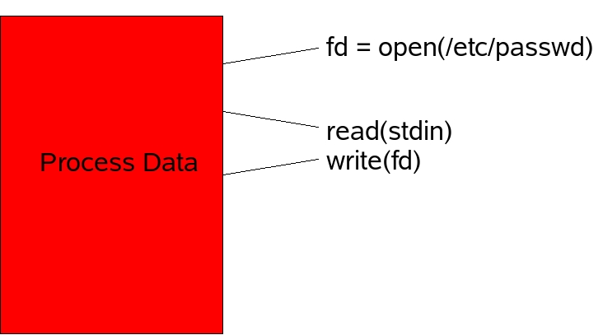
The Bad Idea

Slide 8
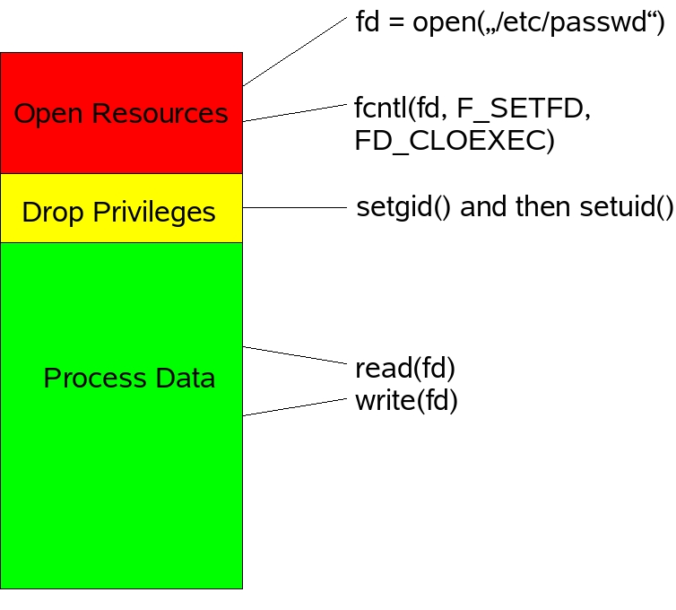
Drop Privileges

Slide 9
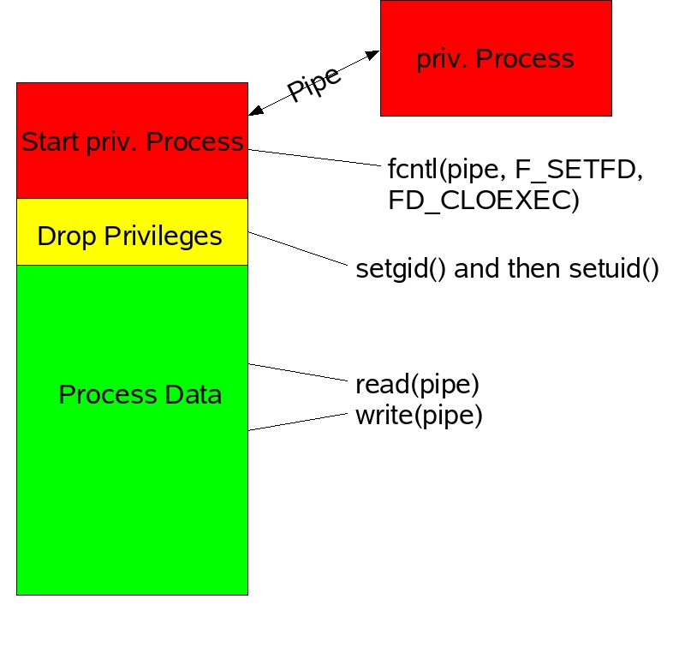
Fork a Process

Slide 10
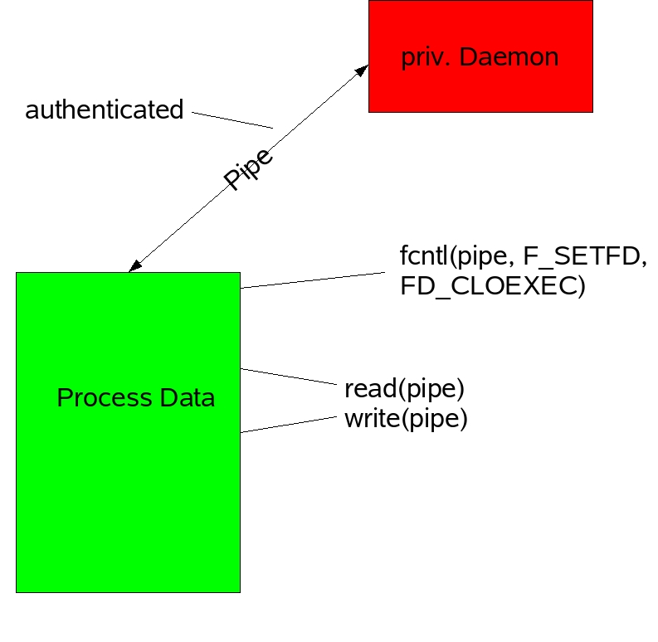
Daemon

Slide 11
A Content Management System

Slide 12
Requirements
remote Network Connections (TCP)
a secure Channel (SSL)
parallel Sessions
Authentication (LDAP)
create, open, edit HTML Files
upload binary Files into a SQL Database
view Documents (merge Files)

Slide 13
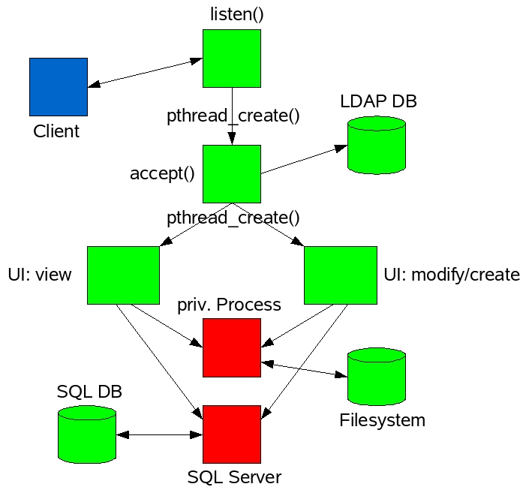
Overview

Slide 14
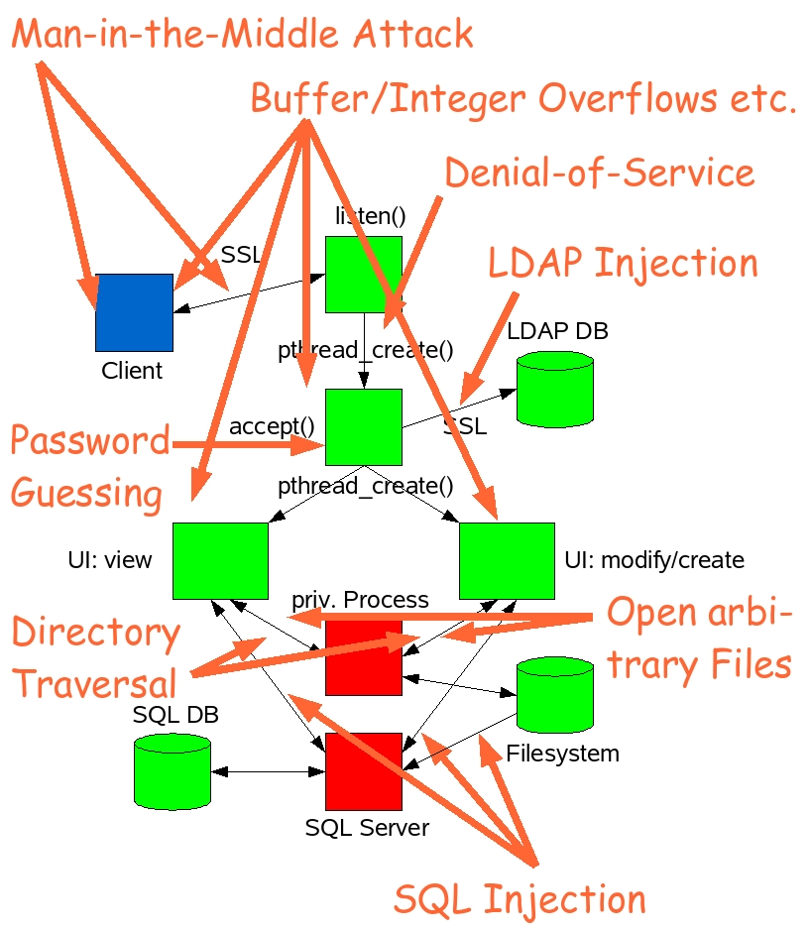

Slide 15
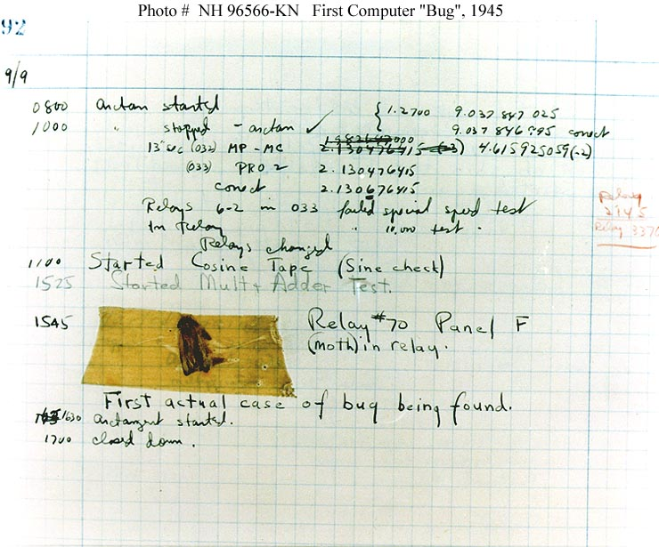
Programming Errors

Slide 16
Buffer Overflows
modular Arithmetic
Race Conditions
Format String Bugs
Keyword Injection

Slide 17
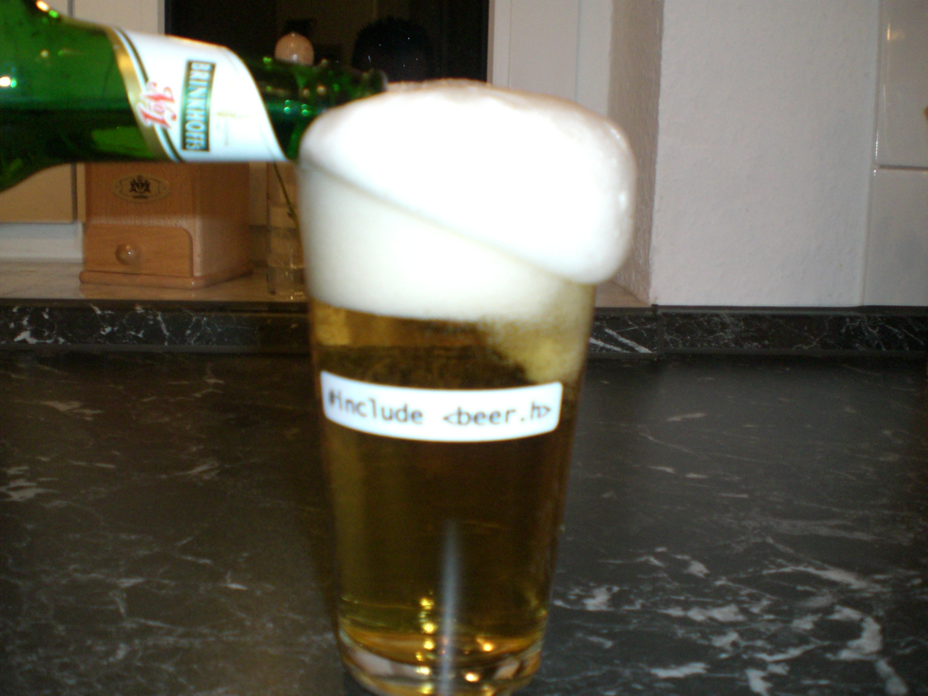
Buffer Overflows

Slide 18
ziptool - strncat(3)
switch(oper)
{
case MOUNT_DISK:
strncpy(cmd, MOUNT_CMD, strlen(MOUNT_CMD)+1);
strncat(cmd, “ -t ext2 “, 9);
strncat(cmd, dev, strlen(dev)+1);
strncat(cmd, “ “, 1);
...

Slide 19
What to avoid?
blindly using strcpy(), strcat(), sprintf()
using strncpy(), strncat(), snprintf() with wrong Parameters
Loops to copy Arrays w/o Bounds-Checking
writing Functions with Array Parameter but w/o Array-Size Parameter
trusting Input... be paranoid!

Slide 20
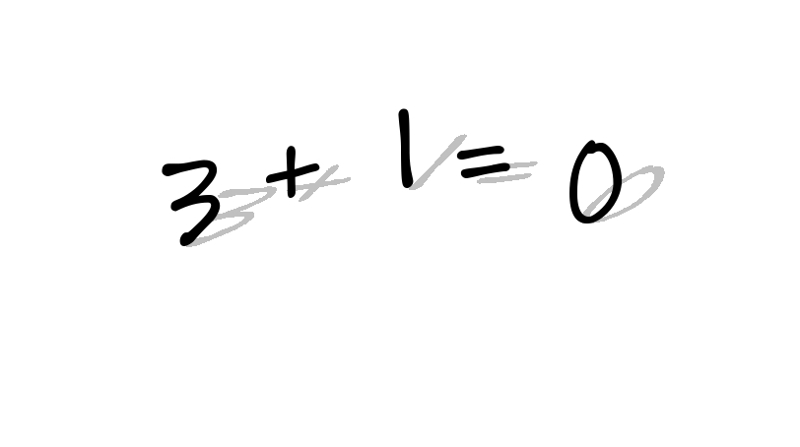
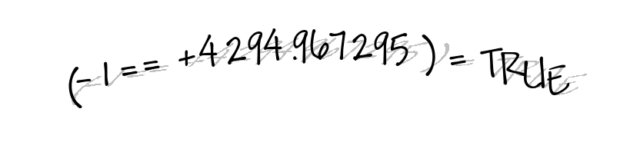
Integer Overflows
Type Mismatch
Signed Issues

Slide 21
unsigned
unsigned
+ 1
1111 1111
0000 0000
signed
unsigned
type cast
1000 0001
1000 0001
-32.767
32.767
signed
unsigned
type cast
1000 0001
1111 1111 1000 0001
-32.767
4.294.934.529

Slide 22
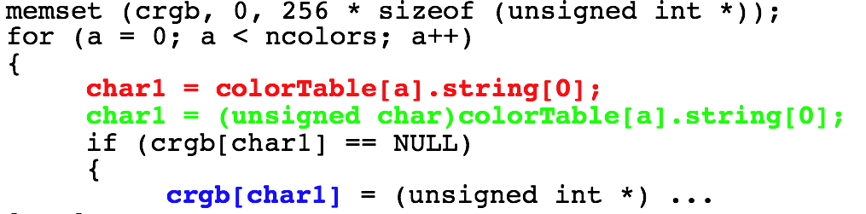
smalltalk: Type Mismatch

Slide 23
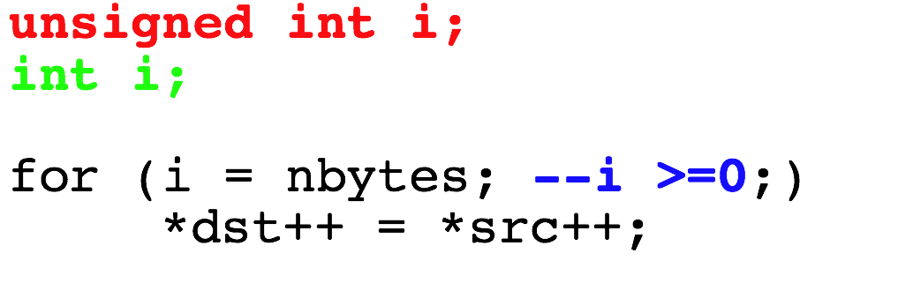
X11: Signed Issue?

Slide 24
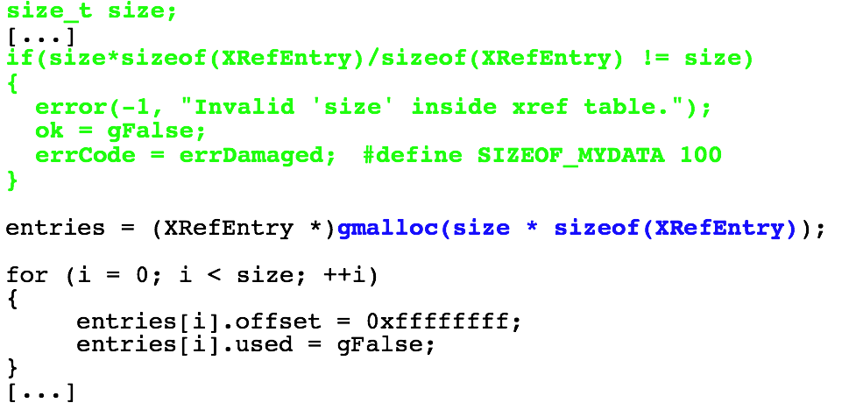
xpdf: 32 Bit vs. 64 Bit

Slide 25
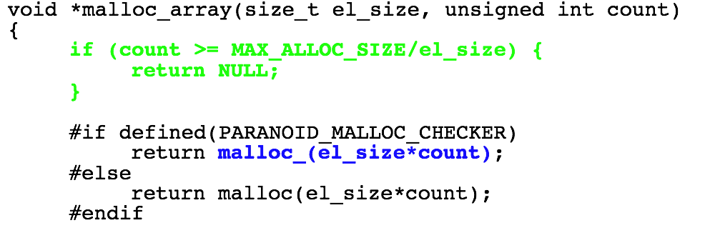
Samba: Valgrind is evil ;-)

Slide 26
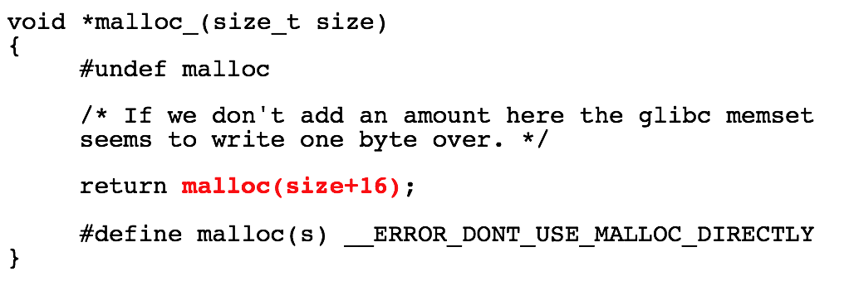
Samba: Valgrind is evil ;-)

Slide 27
What to take care off?
Test for upper/lower Limits and Overflows
Take care: Overflows are undefined for signed Integers
Be type-safe!
does not only affect C!

Slide 28
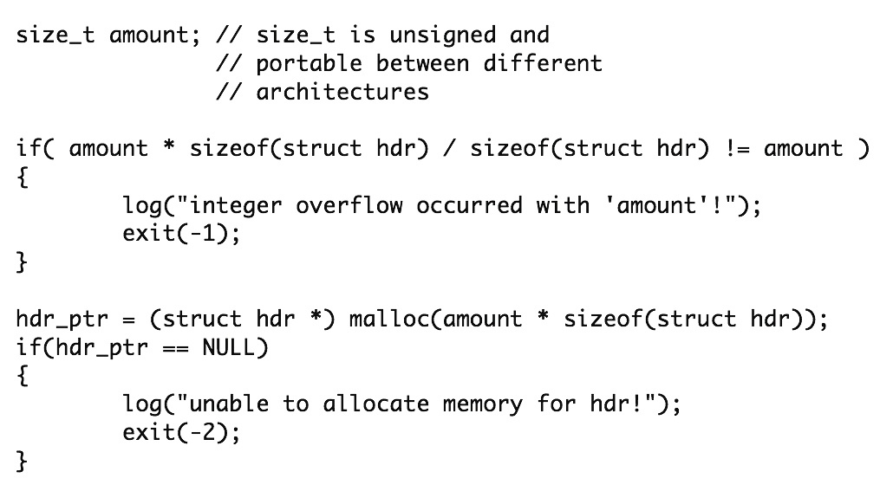
Test

Slide 29
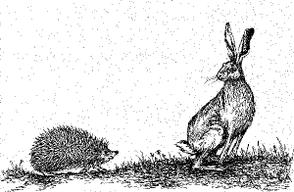
Race Conditions

Slide 30
Where?
Filesystem
multithreaded Code
distributed Databases
Signals and Interval Timer (Process)
etc.

Slide 31
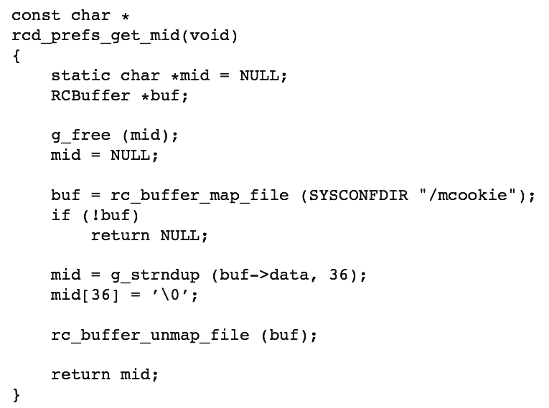
RC Server (multi-threaded)

Slide 32
RC Server (multi-threaded)
Double Free Bug due to missing Locking in multi-threaded Situation
  Result: Crash!
Lessons learned:
  use Locking (mutex)
  do not use static Buffers

Slide 33
CASA’s Unix Domain Socket

Slide 34
CASA’s Unix Domain Socket The Attack
Attacker: ln -s /etc/passwd /tmp/.novellCASA
CASA: calls UnixEndPoint(/tmp/.novellCASA)
CASA: UnixFileInfo() is a Wrapper for stat(2) and follows symbolic Links: stat(/etc/passwd)
CASA: /etc/passwd is root-owned and therefore the Check for the Ownership succeeds

Slide 35
CASA’s Unix Domain Socket The Attack
Attacker: removes the Link, creates a real Socket, and attaches his Daemon
CASA: connects to this Socket (by Name)
Attacker: steals every Secret from the Client

Slide 36
How to avoid them
use Filedescriptors not Filenames
O_NOFOLLOW, O_CREAT|O_EXCL
setgid(2), initgroups(3), setuid(2) (Order!)
fork(2) + drop Privileges
mkstemp(3)
mktemp(1)
lock shared Resources while using them

Slide 37
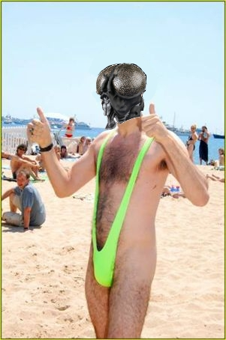
Format
String
Bugs

Slide 38
published in Year 2000
printf-like Functions
read: %x, %p
write: %n (does not work with current glibc)
wrong
snprintf(buf, sizeof(buf), user_data)
right
snprintf(buf, sizeof(buf), “%s”, user_data)

Slide 39
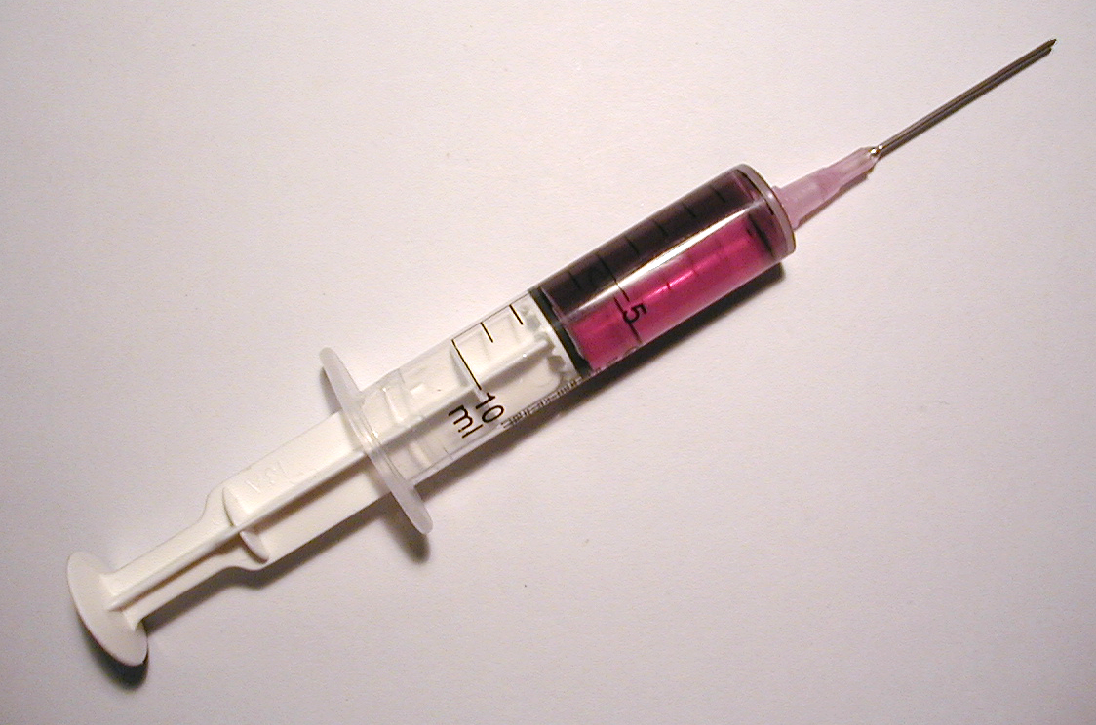
Keyword Injection
SQL Injection
Terminal Escape Sequences

Slide 40
ntop - popen(3)
if(num == 0) putenv(“QUERY_STRING=”);
sprintf(line, “%s/cgi/%s”, getenv(“PWD”), cgiName);
if((fd = popen(line, “r”) == NULL) { ...
cgiName = “;/bin/rm -rf /”

Slide 41
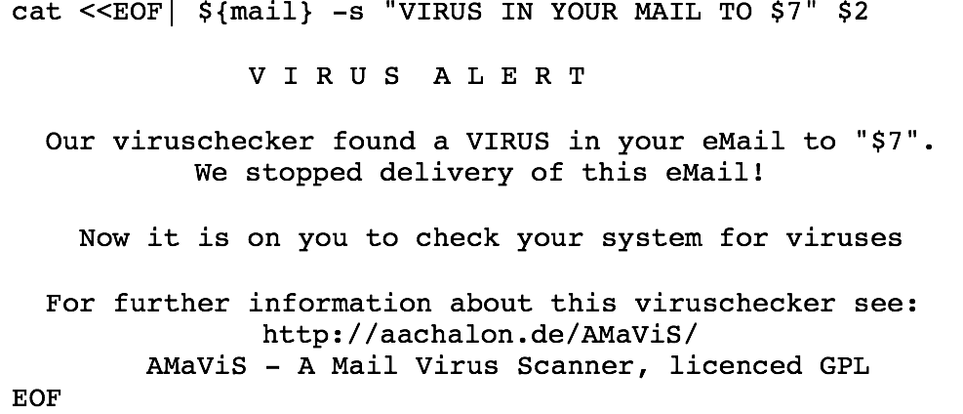
AMaViS: Execute Shell

Slide 42
Ok, what should I do?
Filter/Sanitize untrusted Input
White-List vs. Black-List
a-zA-Z0-9\s is often sufficient
use Escape-Functions, like mysql_ real_string_escape()
avoid Functions that use the Shell, like popen(3), system(3), glob() (Perl), <> (Perl), etc.

Slide 43
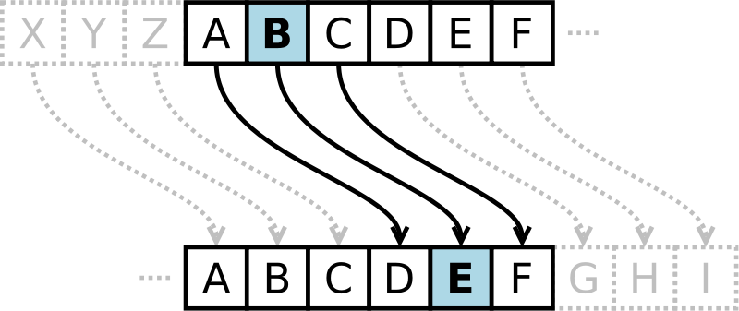
Cryptography
and
Randomness

Slide 44
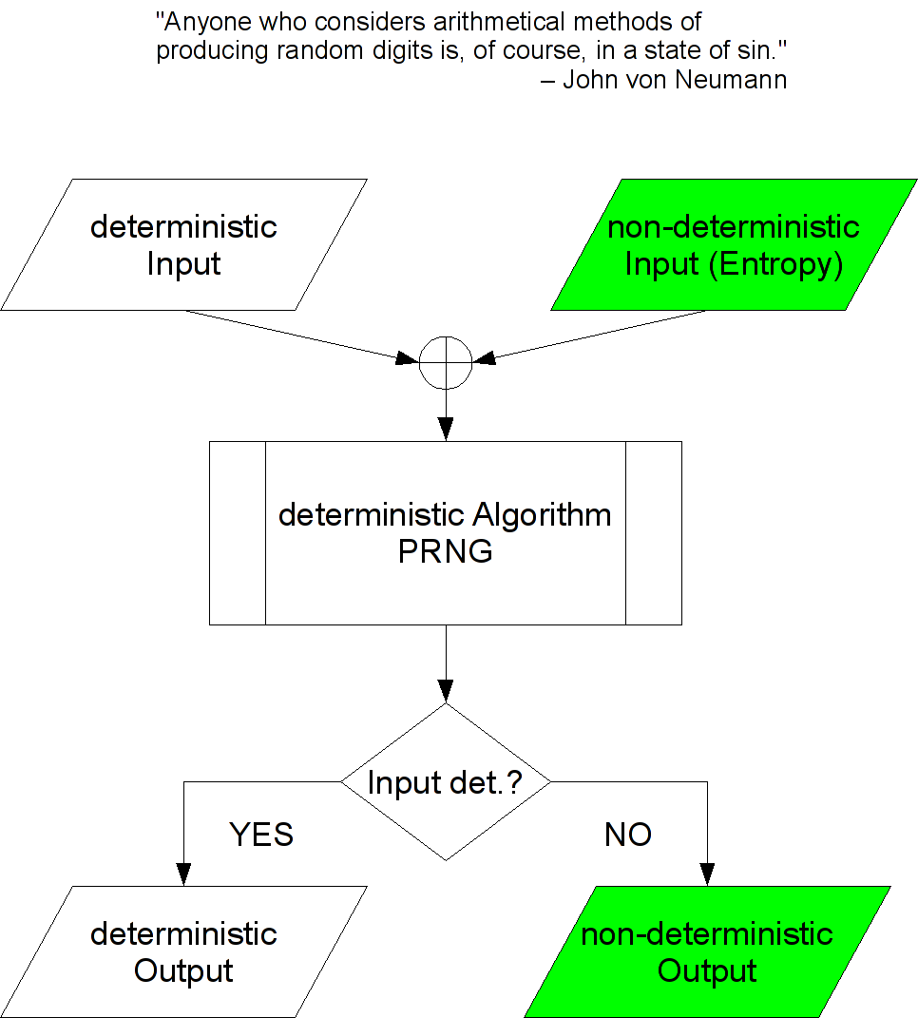

Slide 45
Random Numbers
max. Entropy: Hmax = 1, if P = 0,5 +/- e; for e = 0
statistical Randomness vs. cryptographical Randomness
important Building Block for Algorithms and Protocols
... but hard to find on a deterministic Machine

Slide 46
Dos | Don'ts
use /dev/random (keys) or /dev/urandom | use of fread(3) causes buffering and unneeded waste of entropy
use EGADS or EGD otherwise, or user-generated entropy and use this seed as IV for a Counter-Mode Block-Cipher | using a PRNG from a software library (like rand(3) etc.), only statistical randomness, no Forward Security
use a random/changing Salt (avoid Code-Book attack) for password generation | using the system time, b/c only provides a few bits of entropy
use random/changing IV otherwise the first block in a CBC encryption leaks information | XOR as encryption algo. and timestamp/non-random value as key/One-Time-Pad

Slide 47
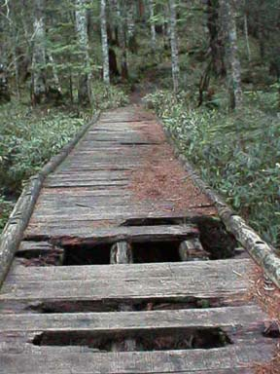
Secure Socket Layer
SSL and TLS

Slide 48
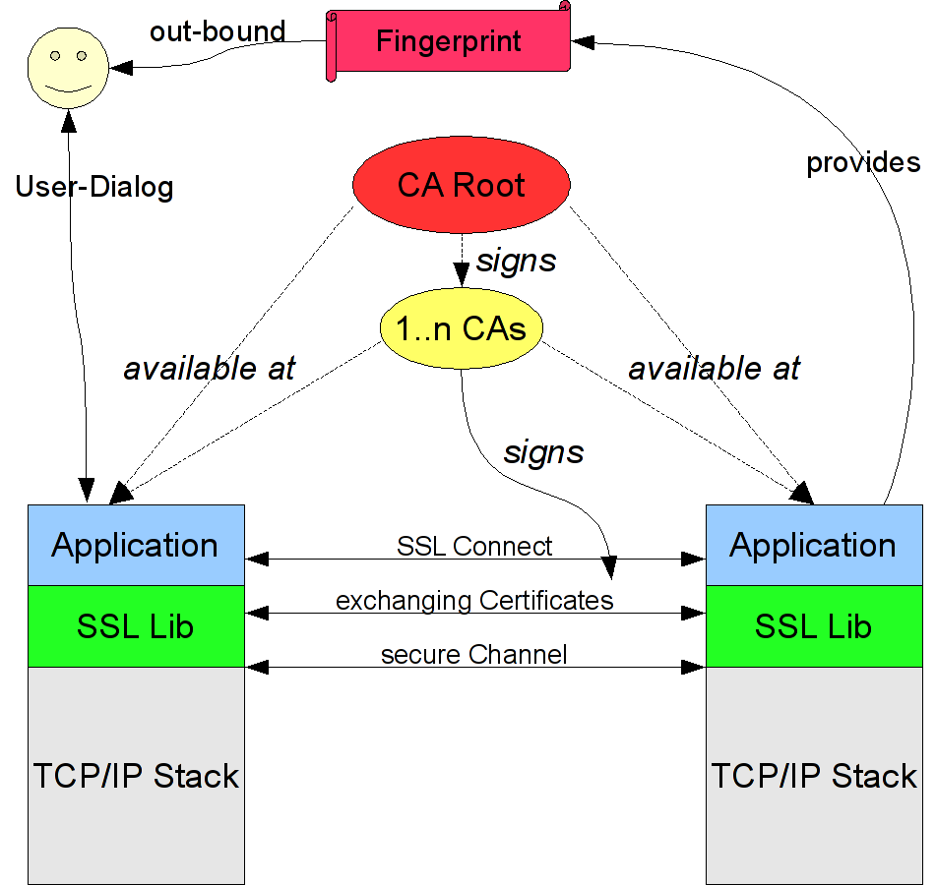

Slide 49
Bad Idea | Reason/Consequences
do not verify certs | attacker can provide his own cert
too short user-dialog | too less information about the cert, accepted to continue work
missing cert-fingerprint in user-dialog | FP to exactly identify cert (self-signed), accepted to cnt. work
MD5 fingerprint only | MD5 not secure anymore, better use MD5+SHA1
do not be too user-friendly and just import possible missing (CA-)cert | too tricky and can possibly attacked to bypass cert verification

Slide 50
Bad Idea | Reason/Consequences
blindly trusting every scripting language to fully support SSL | Python, for example, provides an ssl class but does not verify the certs, better read the API manual
use SSLv2, out-dated or „exportable“ algorithms | known to be vulnerable
Too small keys | sym. ciphers >= 128 bit asym. ciphers >= 1024 bit
no ephemermal keying | no perfect forward secrecy (PFS)
PRNG seed with low entropy | keys may be guessed etc., at least as much entropy as key length needed (better more)

Slide 51
What can I do?
Am I safe with AppArmor, SELinux, etc.? No!
Am I safe with all this nifty gcc Options? No!
So, am I lost? No!
  fully understand the Prg. Language you use
  check your Program’s Input (Type, Size, ...)
  use existing Crypto Libraries when needed
  if in doubt, ask the Security-Team other Developers

Slide 52
Tools
splint too quickly check C code
FindBugs for Java
gdb/strace/ltrace to trace/change code while running
try the various fuzzers availbale online
cscope/kscope to browse the code, generate call-graphs etc.
wireshark to analyze network traffic
an arbitrary SSL MiM tool (ethercap, write your own!)
much more + the various commercial code analyzers

Slide 53
Readings
http://www.suse.de/~thomas/papers/
http://www.dwheeler.com/secure-programs/
http://www.owasp.org/
Seacord, Robert; The CERT C Secure Coding Standard; Addison-Wesley Longman
Viega, John; McGraw, Gary; Building Secure Software: How to Avoid Security Problems the Right Way; Addison-Wesley Longman
Huseby, Sverre; Shafir, Angelika; Sicherheitsrisiko Webanwendung: Wie Web-Programmierer Sicherheitslücken erkennen und vermeiden; Dpunkt Verlag
Ferguson, Niels; Schneier, Bruce;Practical Cryptography; Wiley & Sons
Zeller, Andreas, Why Programs Fail; dpunkt Verlag

